Slide 1




Chikungunya Infection During Gestation: Impact on Pregnancy and Neonatal Outcomes

Slide 2
Chikungunya Virus
Chikungunya (CHIKV): mosquito-borne (Aedes spp.) positive sense RNA Alphavirus in the family Togaviridae
Officially discovered in 1952 by R. W. Ross on the Makonde plateau in Tanzania: Makonde language for “that which bends up”
Causes chikungunya disease in humans (3-7 days incubation):
Joint and body pain (arthralgia)
Fever
Headache
Nausea
Vomiting
Rash
Acute (days to weeks) and chronic (months to years) phases

Slide 3
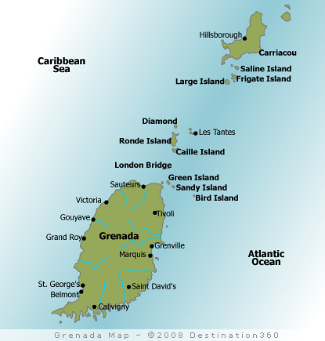

Chikungunya Virus in Grenada
CHIKV emerged in the Americas (via Caribbean) December 2013 (St. Martin)
Main island of a tri-island state of Grenada, Carriacou, and Petit Martinique in the southern Antilles
First reported in Carriacou in June 2014 and then quickly spread to all 6 parishes in Grenada
By December 2014: 65% of the population was infected with CHIKV (MOH, Grenada)^{1,2}
¹Jungkind et al., 2015 ²Macpherson et al., 2016

Slide 4
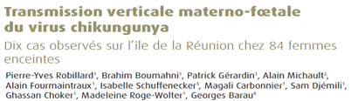
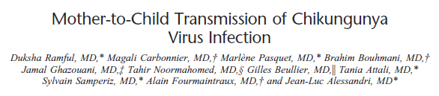
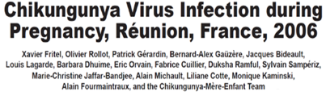
Maternal-Fetal Transmission of Chikungunya Virus

Slide 5
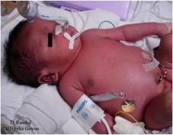
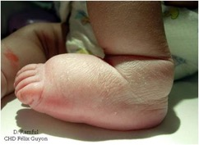
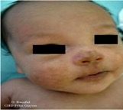
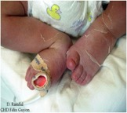
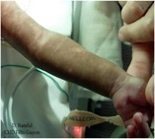
Mother-to-child Transmission
To date know to occur exclusively in the context of intrapartum maternal viremia and often leads to severe neonatal infections
Rate of MTCT during pregnancy = 2.5%
Rate of MTCT DURING DELIVERY = 50%
Case fatality rate = 2 - 5%
Common neonatal symptoms include:
Fever (100%)
Pain (100%)
Suckling difficulties (100%)
Rash (89%)
Distal limb edema (84%)
At 2 years, Mean DQ 83 and 51% had Global Neurodevelopmental Delays
At 10 years, survivors have language delays, hearing and visual impairment and need for PT and OT.
Gérardin P et al, PLoS Med, 2008; Ramful D et al, Pediatr Infect Dis J 2007; Ritz N, et al, Pediatr Infect Dis J 2015; Gérardin P et al, PLoS Negl Trop Dis, 2014; Gérardin P, A.D. LaBeaud et al, 2016
Notes:
Mother-to-child chikungunya virus transmission is frequent in the context of intrapartum maternal viremia, and often leads to severe neonatal infection. Chikungunya represents a substantial risk for neonates born to viremic parturients that should be taken into account by clinicians and public health authorities in the event of a chikungunya outbreak.
Systematic review
Overall rate of MTCT = 9.5%
Vertical transmission rate was 39% (172/439) for pregnant women infected at >35 weeks gestation
Case fatality rate = 2 - 5%
Viremic phase:
Median onset: 4 days (range 3-7 days)
Fever (100%)
Pain (100%)
Suckling difficulties (100%)
Rash (89%)
Distal limb edema (84%)
Post-viremic phase:
Hyperpigmentation
Peeling
19 children with congenital CHIKV:
Severe encephalopathy (9)
Non-encephalopathic CHIKV (10)
13 children assessed at follow up:
Language delays requiring speech therapist (7)
Hearing impairment (2)
Central deafness (1)
Visual impairment (4)
Cortical blindness (1)
Myopia (2)
Strabismus (1)
Need for physical therapy (4)
Need for orthopedic care (3)
Botulinum toxin required for spasticity (2)

Slide 6
CHIKV Pregnancy Outcomes & Infant Neurodevelopment in Grenada Aims
Aims
1. Determine the prevalence of MTCT of CHIKV in Grenadian pregnant mothers
2. Measure neurodevelopment in children at 2 years of age exposed to CHIKV at different trimesters in utero
3. Assess the burden of confounding factors to better understand the specific impact of VBD on neurodevelopment and inform public health priorities
4. Build local capacity for arboviral and neurodevelopmental testing at St. George’s University in Grenada

Slide 7
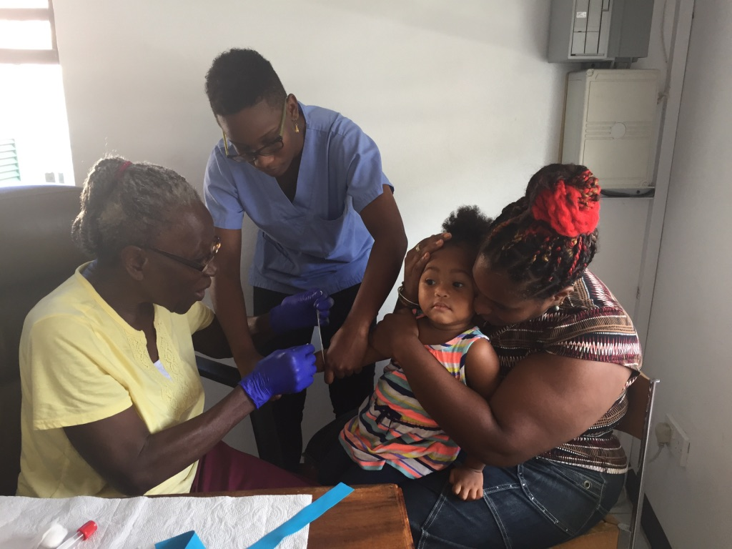

Study Design- ongoing through August 2018
Enroll approximately 1000 mothers and their children who gave birth during and after the CHIKV outbreak
Completion of multiple questionnaires about home environment, relationships, food security and pregnancy outcomes
Measure child’s neurodevelopment using Intergrowth-21st Neurodevelopment Assessment (interNDA) including hearing and vision
Test mother and child blood for prior exposure to CHIKV using InBIOS IgG ELISA
Compare neurodevelopment in those children born to mothers with CHIKV exposure during pregnancy to those with mothers infected outside of pregnancy

Slide 8





CHIKV Pregnancy Outcomes & Infant Neurodevelopment in Grenada
NEG
78/438
17.8%
POS
15/436
3.4%
NEG
421/436
96.6%
POS
360/438
82.2%

Slide 9
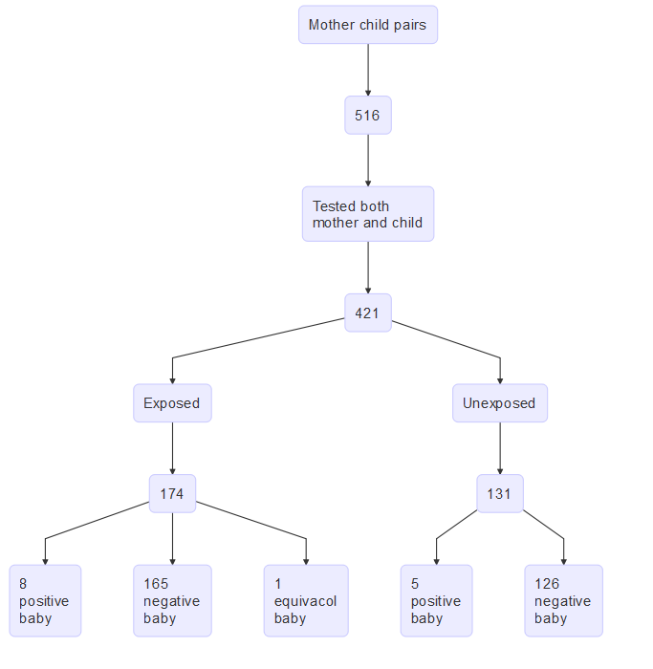
Cohort
Exposed (if both)
Mother IgG+
AND infected during pregnancy
Unexposed (if either)
Mother IgG -
OR not infected during pregnancy
Excluded 116
112 CHIKV+ without timing of infection information
3 no recall if during pregnancy
1 recalled disease during pregnancy but not CHIKV+

Slide 10
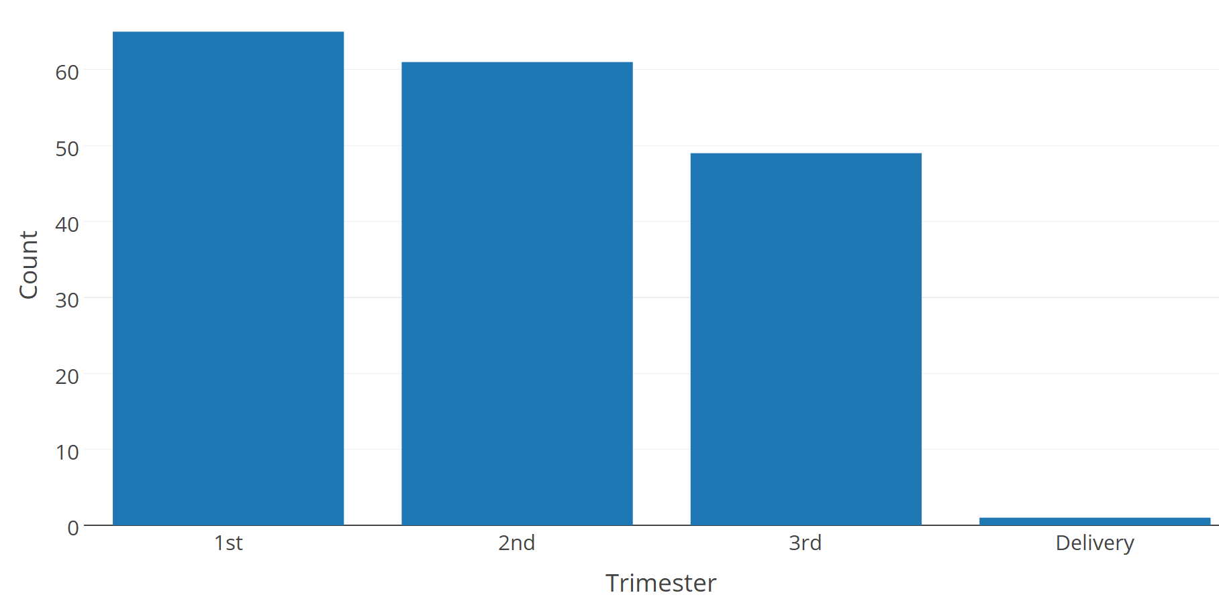
Trimester of Infection
65
61
49
1

Slide 11
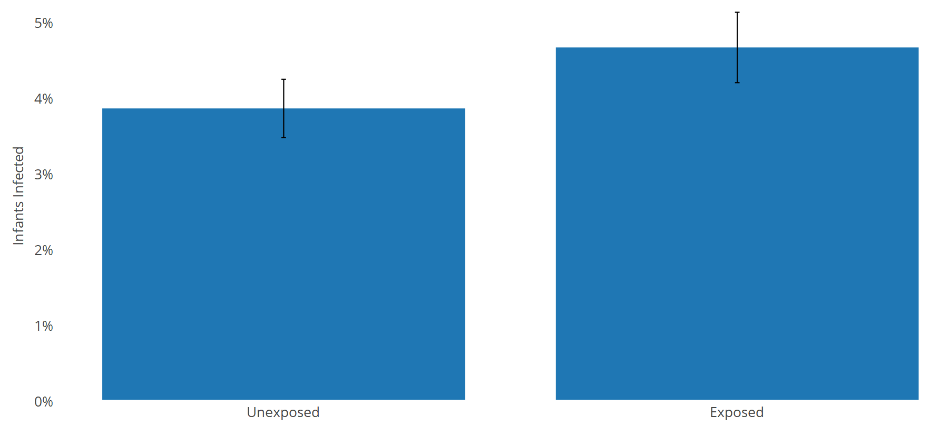
IgG Positive Infants by Mother exposure status
5/131
3.8%
8/173
4.6%
p= 0.956

Slide 12
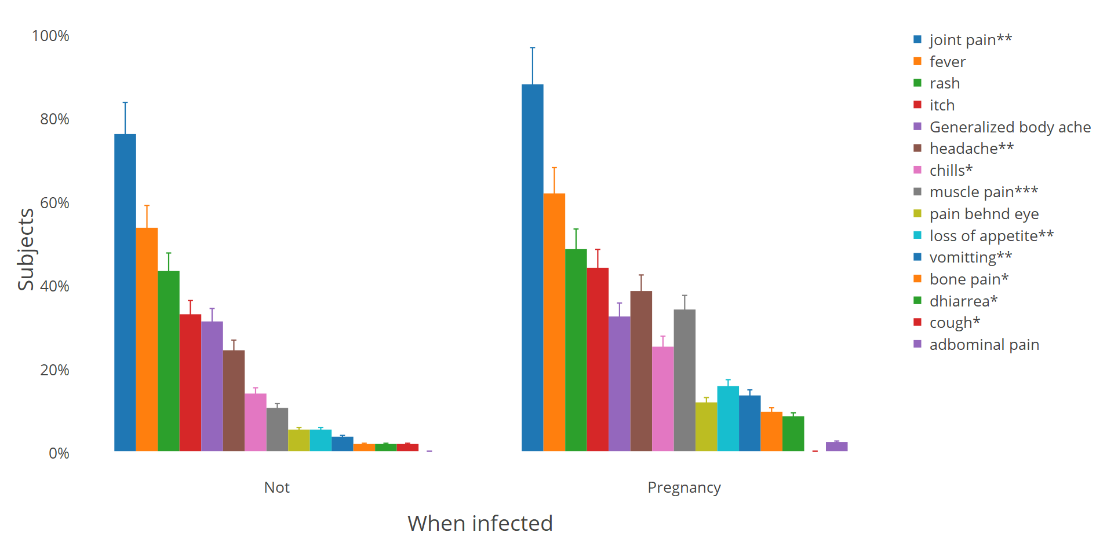
CHIKV symptoms during pregnancy vs not
(n=93)
(n=198)
***<0.001.**p<0.05. *p<0.10

Slide 13
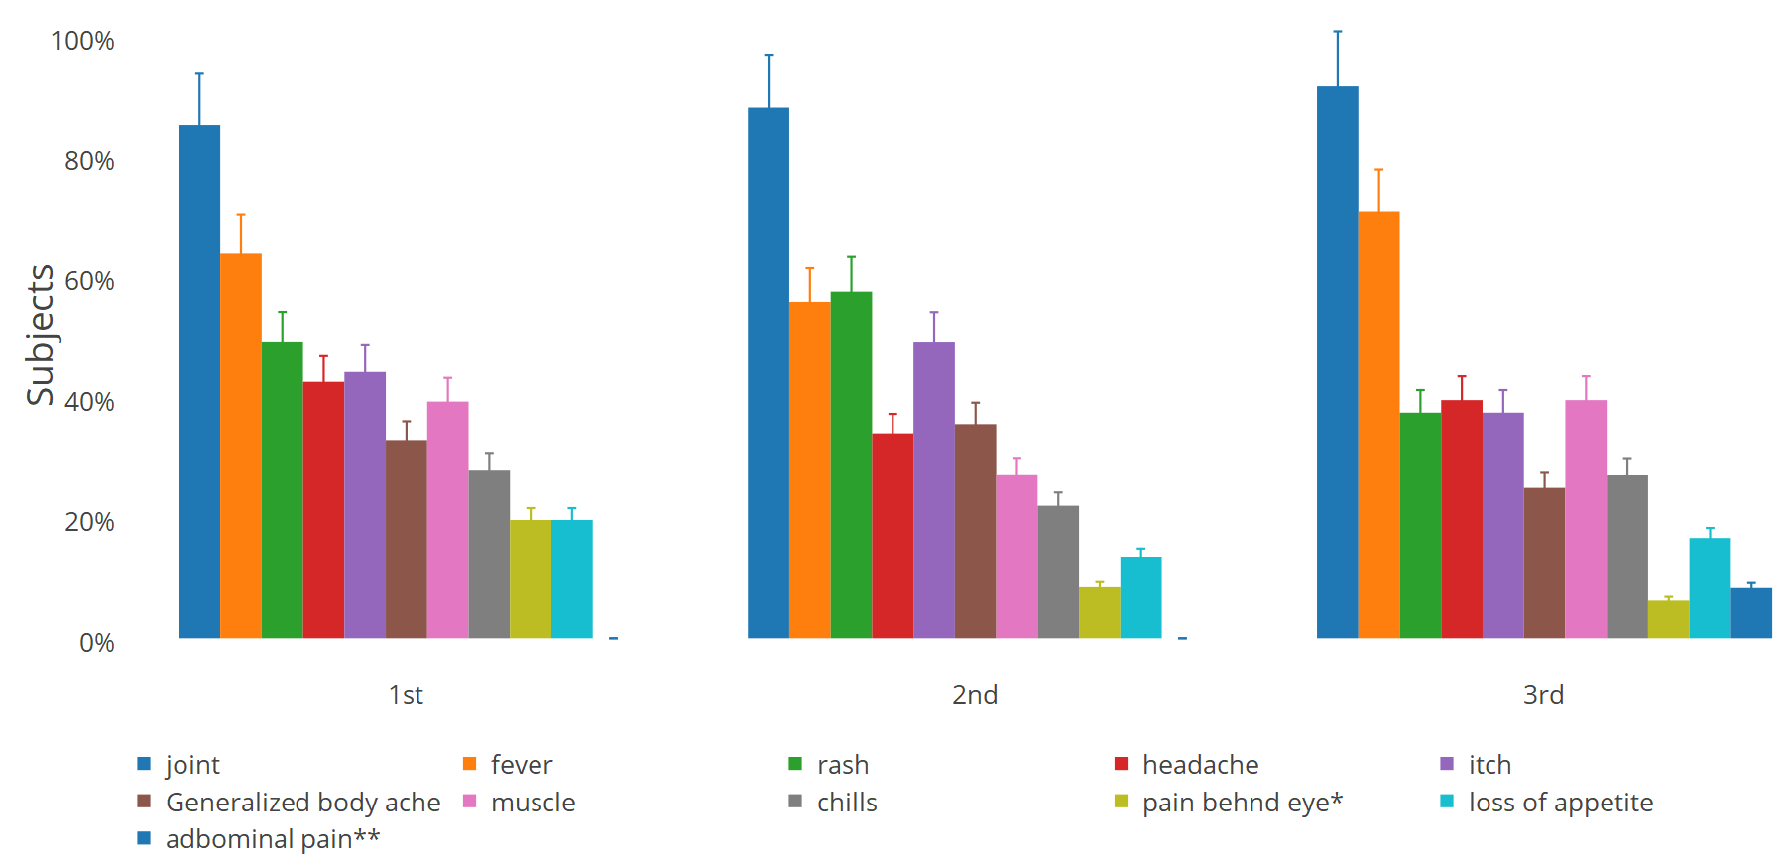
Symptoms by Trimester of Infection
(n=70)
(n=61)
(n=53)
**p<0.05. *p<0.10

Slide 14
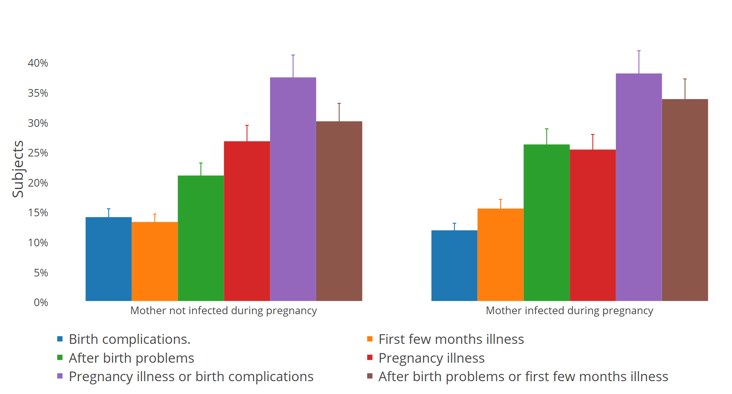
Pregnancy and birth complications
Notes:
See table.

Slide 15
Pregnancy and Birth Complications by Trimester of Infection

Slide 16
1st trimester | P =
2nd trimester | P =
3rd trimester | P =
Pregnancy
Abruption | 0.112
Hypotension | 0.140
Reflux | 0.112
Previa | 0.112
Pregnancy
Headache | 0.106
Hyperglycemia | 0.077
Posterior Positioning | 0.106
Previa | 0.112
Pregnancy
Breech | 0.073
Headache | 0.073
Hyperglycemia | 0.035
Reflux | 0.073
Pain | 0.073
Previa | 0.073
After birth
Bloody stools | 0.106
Bronchitis | 0.008
Rash | 0.130
Sinus issues | 0.106
Murmur | 0.106
Omphalitis | 0.106
Otitis | 0.106
Fever | 0.106
Pneumonia | 0.106
Seizures | 0.106
FFM sum | 0.088
After birth
Mastitis | 0.112
Bronchitis | 0.112
Rash | 0.037
Jaundice | 0.066
Poor feeding | 0.112
After birth
Head swelling | 0.073
Bronchitis | 0.073
Club foot | 0.073
Fever | 0.011
Flushed | 0.073

Slide 17
Gestational Age at Delivery by Exposure
p=0.7
Notes:
Unexposed 39.69 weeks vs 39.71 weeks for exposed.

Slide 18
Height Weight at age 2 years
P=0.03
P=0.9

Slide 19
Conclusions
Ongoing study adds to the limited data on the effects of CHIKV infection during pregnancy on birth outcomes
No difference between child infection rates in mothers exposed during pregnancy vs, unexposed/exposed outside of pregnancy
Pregnant women had similar symptoms, but were more symptomatic than non-pregnant women
Symptoms did not vary by trimester
There was a trend toward more after birth complications in the CHIKV gestationally exposed group
Many complications tended to be higher in the exposed group in first (rash), second (bronchitis), third trimester (hyperglycemia, fever)
No differences in gestational age at delivery
CHIKV gestationally exposed infants were heavier at 2 years than unexposed
Study is ongoing….stay tuned

Slide 20


Acknowledgements
WINDREF/St. George’s University
Randall Waechter, Trevor Noel, Calum Macpherson, Nikita Cudjoe, Veronica Mapp Alexander, Barbara Landon, field teams
Stanford University
Priyanka Suresh
Amy Krystosik
Oxford University
Michelle Fernandes
Grenada MOH
George Mitchell
CHU ReUnion
Patrick Gerardin
Our study participants
Funder: NIH Fogarty R21TW010536: LaBeaud/Waechter

